Slide 1
Mid-Hudson Energy Choices
Putting knowledge to work to help you make informed energy choices.
MidHudsonEnergyChoices.org
Notes:
Insert your text above

Slide 2
Contact
Faith Laudano
Energy Advisor Dutchess County
fll28@cornell.edu
(845) 677-8223 x 126
Notes:
Insert your text above

Slide 3
Roadmap
How Our Current Energy System Hurts Us
2. Funding for the Solutions
3. Steps Toward a Cleaner and Greener Home
4. How We Can Help
5. Contact Us

Slide 4
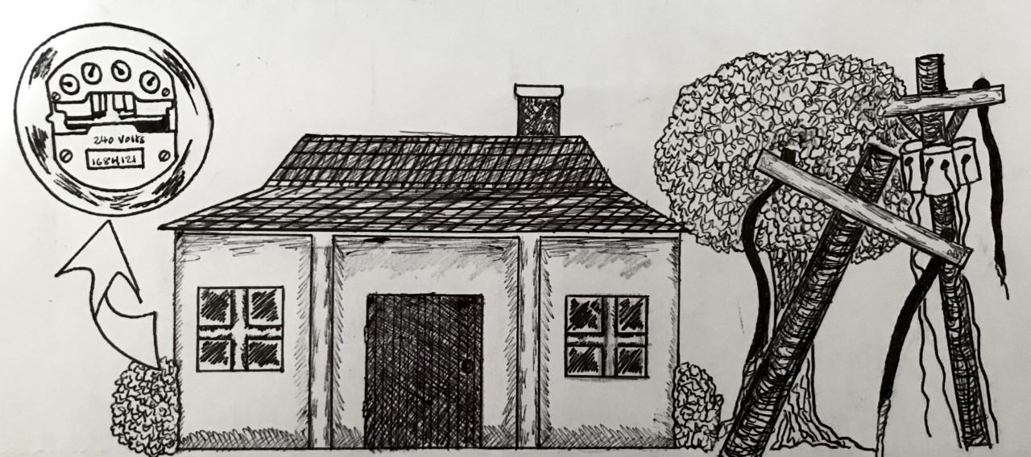
Our Current Energy System is Not Keeping Up With The Times ...
Utility rate increases
Storm damage drives up cost to repair and maintain grid.
Aging Housing Stock
Notes:
Utility Rate Increases:
( Insert Central Hudson/ Gas/ fuel oil rate fact)
Orange and Rockland - "[O&R] currently projects that its average residential natural gas heating customer using an average of 158 ccfs per month will pay $337 a month from November 2022 to March 2023, 44 percent more than the average bill of $234 a year earlier; A typical O&R residential customer using 600 kWh a month this winter will pay about $174, a 28.8 percent increase over last winter’s $135 based on current projections".
Aging Housing Stock: In HV, ~59% was built before 1970. Do you know when the first energy codes were put in place? 1978
Storm Damage/Electric Grid Repairs and Maintenance:
New York – In 2012, after Hurricane Sandy, Con Ed estimated costs of restoring power to customers and repairing the grid to be between $350-450M
In 2015, "the Public Service Commission allowed NYSEG to recover $260M in damage and recovery costs incurred between 2010 and 2015"; these costs were incurred after Tropical Storm Lee and Hurricanes Irene and Sandy
Louisiana - It will cost approx. $4B to repair damage to the electric grid from hurricanes that occurred 2020 and 2021; this will cost their customers an additional $8 per month for 15 years (this adds up!)
Sources:
https://www.coned.com/en/accounts-billing/your-bill/about-con-edisons-rates#:~:text=2022,%2C%20an%20increase%20of%203.9%25.
https://www.cenhud.com/en/account-resources/rates/gas--electric-supply-prices/
https://www.oru.com/en/about-us/media-center/news/2022/20220909/oru-offering-assistance-as-energy-market-prices-surge
https://springfieldhba.com/the-age-of-the-housing-stock-by-state-where-are-the-elderly-homes/
https://www.reuters.com/article/storm-sandy-coned/coned-ny-sandy-power-outages-slip-costs-could-reach-450-mln-idUSL1E8MB14P20121111
https://www.pressconnects.com/story/news/local/2018/03/09/who-pays-utility-repairs-storm-damage-you-do-through-higher-ny-nyseg-rates/399191002/
https://apnews.com/article/wildfires-storms-science-business-health-7a0fb8c998c1d56759989dda62292379

Slide 5
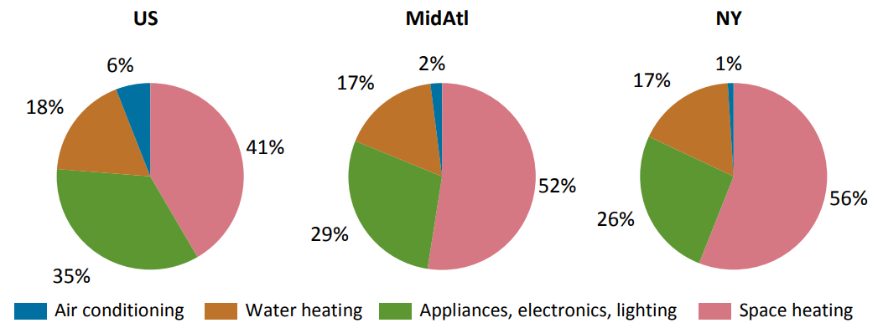
… Which Hurts our Wallets...
Consumption by End Use
Source: U.S.E.I.A. 2009 RECS State Briefs
Notes:
United States Energy Information Administration. Energy Consumption By End Use, 2009, PDF, 829 x 324, https://www.eia.gov/consumption/residential/reports/2009/state_briefs/pdf/ny.pdf.

Slide 6
… And our Health!
Notes:
Regional Asthma Management and Prevention. Unknown [Housing and Health], 2018 ,PDF, 868 x 495, http://www.rampasthma.org/D:Web%20Siteswww.rampasthma.orgwp-contentuploads/2018/12/Energy-Efficiency-and-Health-Guide-for-Public-Health-and-Health-Care-Professionals.pdf.

Slide 7
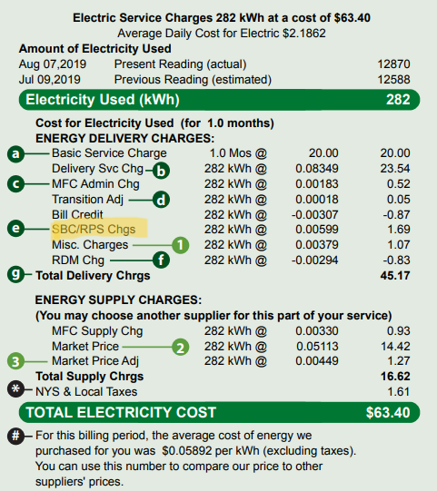
You Already Pay into the Solution.
System Benefits Charge (SBC):
A mandated charge on New York electric utility bills.
This charge funds various state initiatives such as:
Energy efficiency programs for residents, nonprofits and businesses.
Electric utility bill assistance programs.
Energy research and development projects (New York State Energy Research Development Authority, 2014).
(Central Hudson, 2019)
Notes:
Central Hudson. Unknown [Electric Utility Bill], 2019, PDF, 475 x 571, https://www.cenhud.com/globalassets/pdf/billexplained_electric.pdf.
New York State Energy Research Development Authority. "System Benefits Charge". New York State Energy Research Development Authority. June 3, 2014. https://www3.dps.ny.gov/W/PSCWeb.nsf/All/58290EDB9AE5A89085257687006F38D1?OpenDocument.

Slide 8
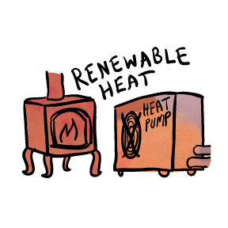
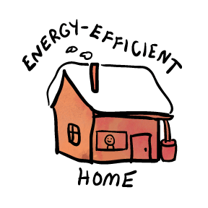
Three Steps to a Cleaner and Greener Home
EmPower+
100% up to $10,000
or
50% up to $5,000
Comfort Home
$1,000 - $4,000
NYS Clean Heat (Rebates)
Air-Source Heat Pumps
Ground Source Heat Pumps
Heat Pump Water Heaters
NY-SUN
$/Watt rebate
Solar for All
No-cost solar subscription
Plus tax incentives and more to come from the Federal Inflation Reduction Act of 2022
Images used with permission from CCE Tompkins
Notes:
NYS Clean Heat rebates depend on: utility service territory, size of heat pump, decommissioning (y/n), full/partial heating load.

Slide 9
The Inflation Reduction Act will Save you Money
Billions of dollars to help homeowners, renters and businesses afford clean energy technology and retrofit work.
Rebates
Anticipated late 2023/ early 2024
Tax Credits
Available now
Combine these with state incentives and programs (on previous slide) to maximize your savings and go electric
Images used with permission from CCE Tompkins

Slide 10
The Inflation Reduction Act will Save you Money
Tax Credits- Available Now!
Energy efficiency upgrades
Electric vehicles
Heat pumps
Heat pump water heaters
Biomass stoves
Solar
Battery storage
NYSERDA IRA homeowner tax incentive informational resource:
https://www.nyserda.ny.gov/All-Programs/Inflation-Reduction-Act/Inflation-Reduction-Act-homeowners
Images used with permission from CCE Tompkins

Slide 11
The Inflation Reduction Act will Save you Money
Rebates – Anticipated in late 2o23/early 2024
Electric/induction stoves
Heat pumps
Heat pump water heaters
Heat pump clothes dryers
Electric wiring and panel upgrades
Energy efficiency upgrades
Images used with permission from CCE Tompkins

Slide 12
Homeowners
Renters
Small Businesses
Nonprofits
Affordable Property Owners
Dedicated Funding
Overcoming Barriers
Prioritizing Underserved Communities
Pilot Projects
Energy Advising
Dedicated Funding
Cohort-style Training
Free Technical Assistance
Mid-Hudson Energy Choices
Advisory Committee
Needs Assessment
No-Wrong-Door Approaches
Community Campaigns
Community Engagement
NYSERDA-supported Statewide Working Groups
10 Regions in NYS
Roundtables
Career Summits
Training Resources
Statewide
Coordination
Workforce Development
Notes:
Insert your text above

Slide 13
We Believe There Should Be No Wrong Door
Plus a network of partnering organizations across the region.
Notes:
We are a team of trusted, knowledgeable, community-based organizations from the Mid-Hudson region of New York. As a Hub, we utilize our knowledge and experience about clean energy, energy efficiency, workforce development, education, health and housing to help individuals, affordable housing owners and small business owners with making informed energy decisions, reducing energy usage/costs, and the benefits of clean energy.

Slide 14
We Would Love to Work With You
Contact an Energy Advisor:
Help navigating programs and incentives.
Outreach opportunities.
Collaborate on Community Campaigns.
Stakeholder input events --> Needs Assessment and Equitable Engagement Plan.
Roundtable for Energy Affordability in Low-Income Groups and Neighborhoods (REALIGN) - Resuming 2023.
Energy Navigator Volunteer Program.
Learn more at MidHudsonEnergyChoices.org
Notes:
Insert your text above

Slide 15
Contact
Faith Laudano
Energy Advisor Dutchess County
fll28@cornell.edu
(845) 677-8223 x 126
Notes:
Insert your text above

